Slide 1


Slide 2
7 Lakes My Courses Program
Presented by PLD Kyaligonza Willis

Slide 3

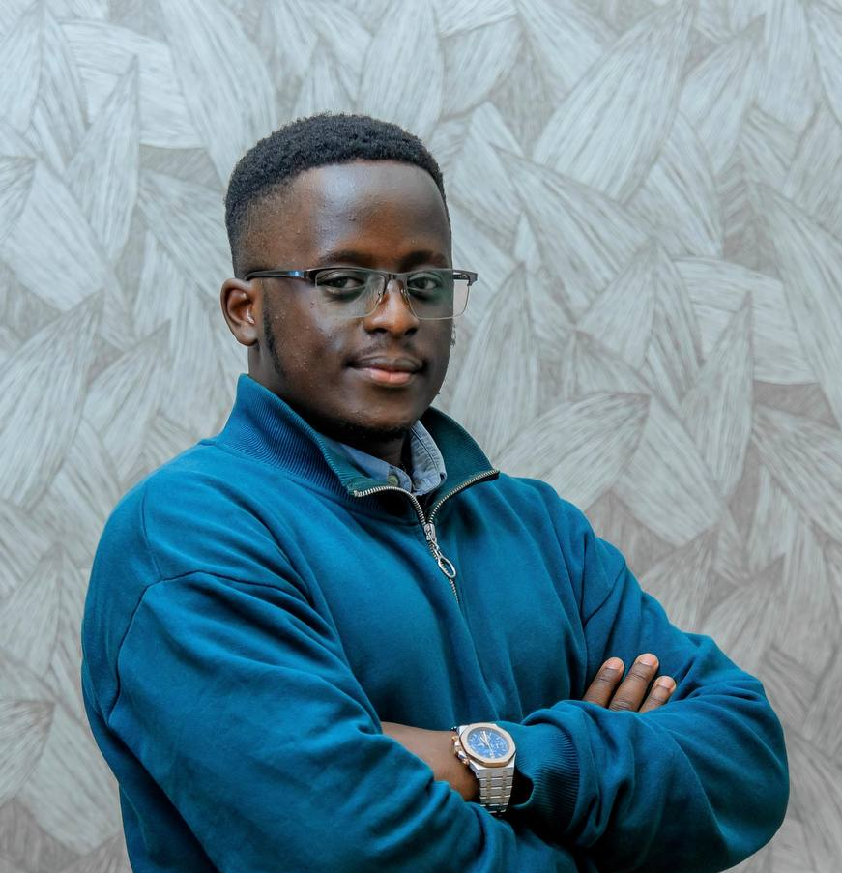
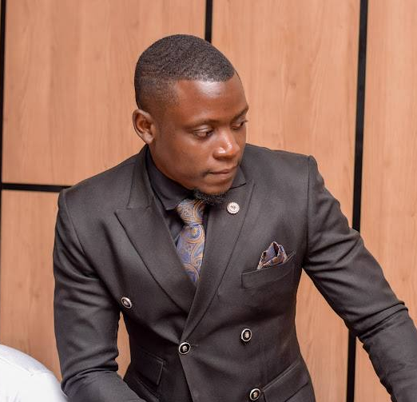
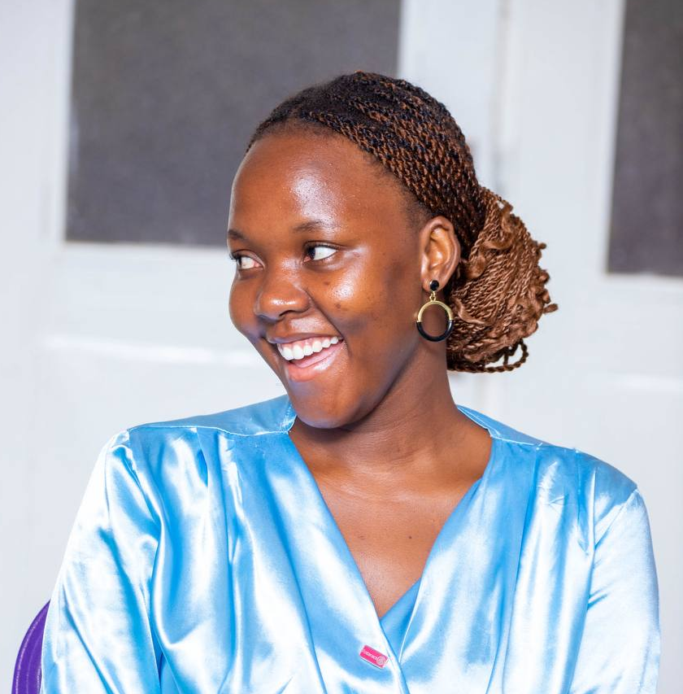
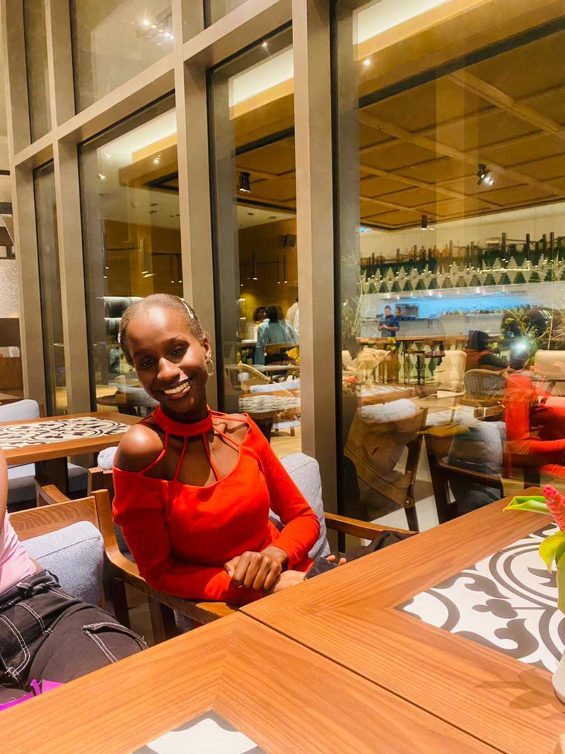
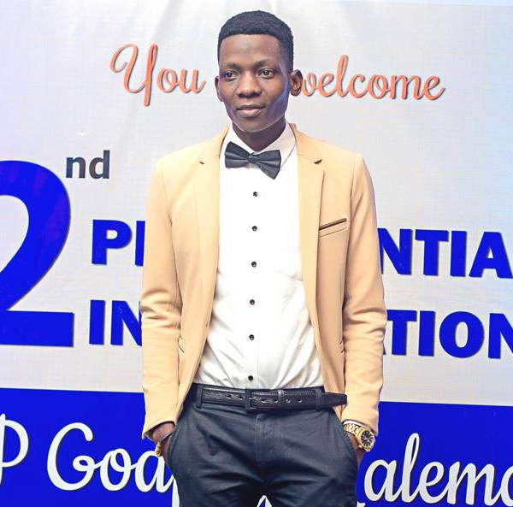
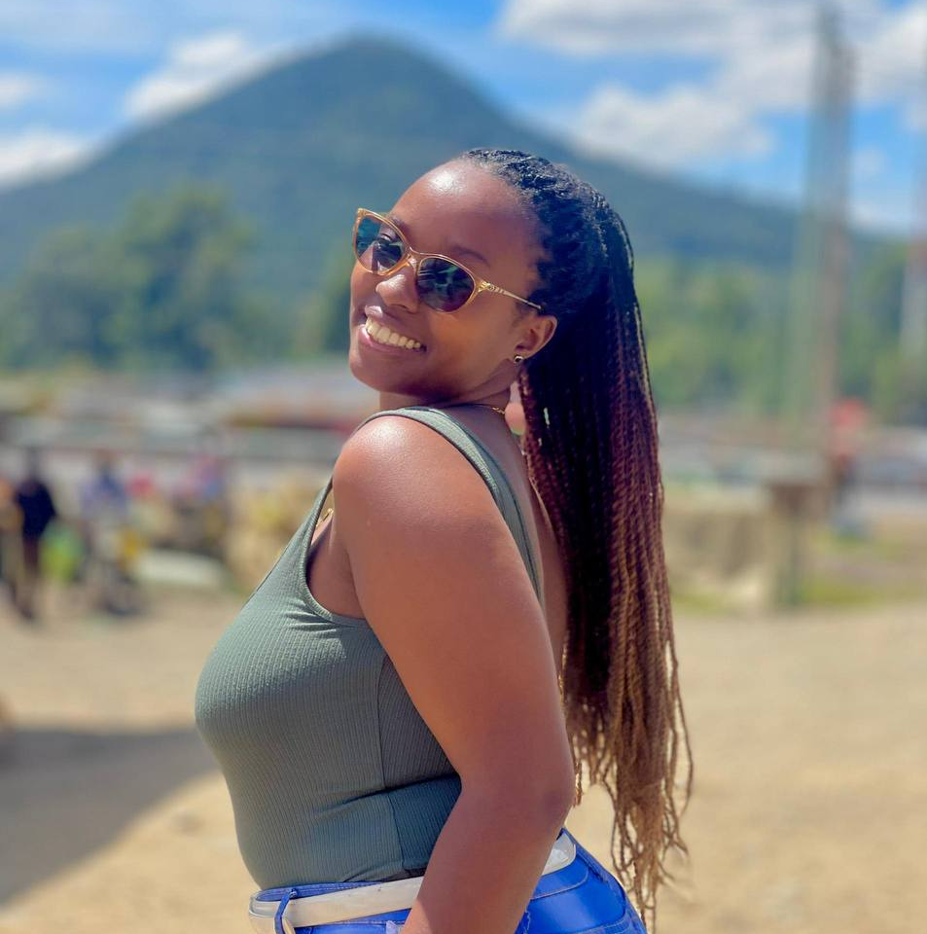
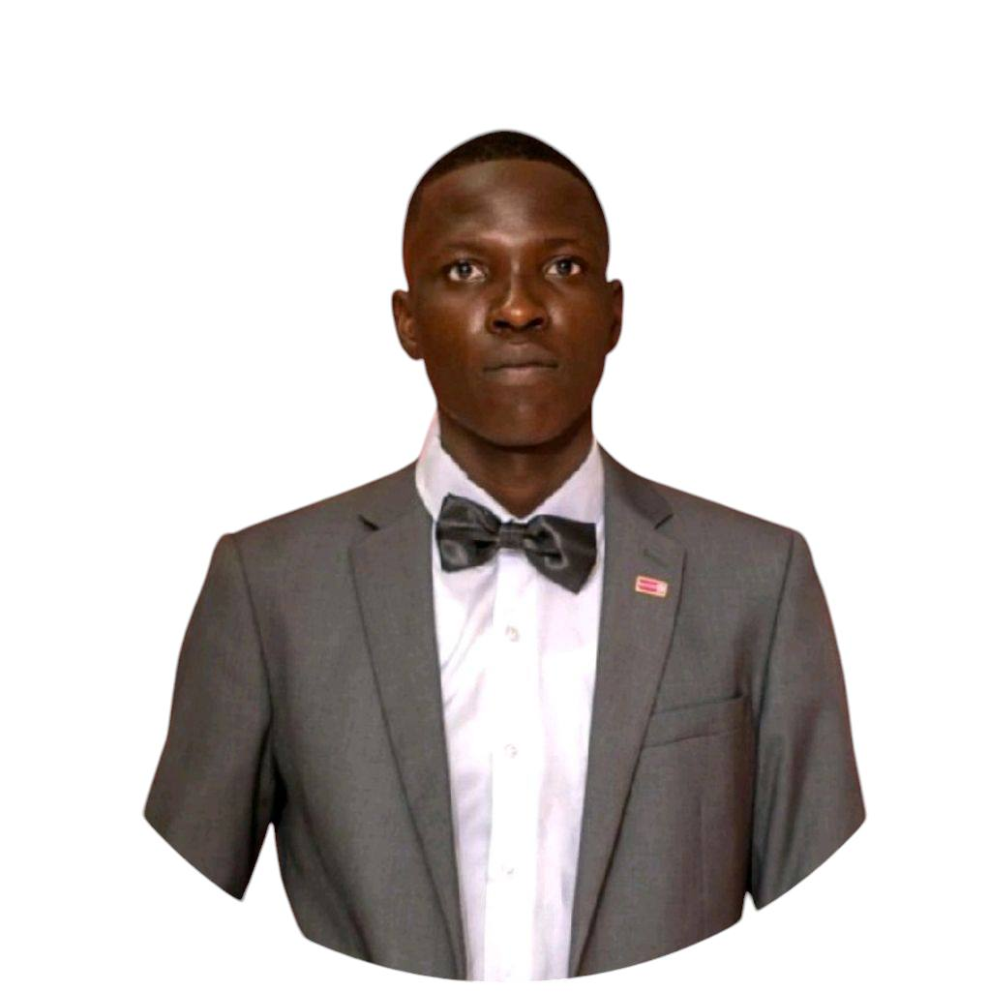
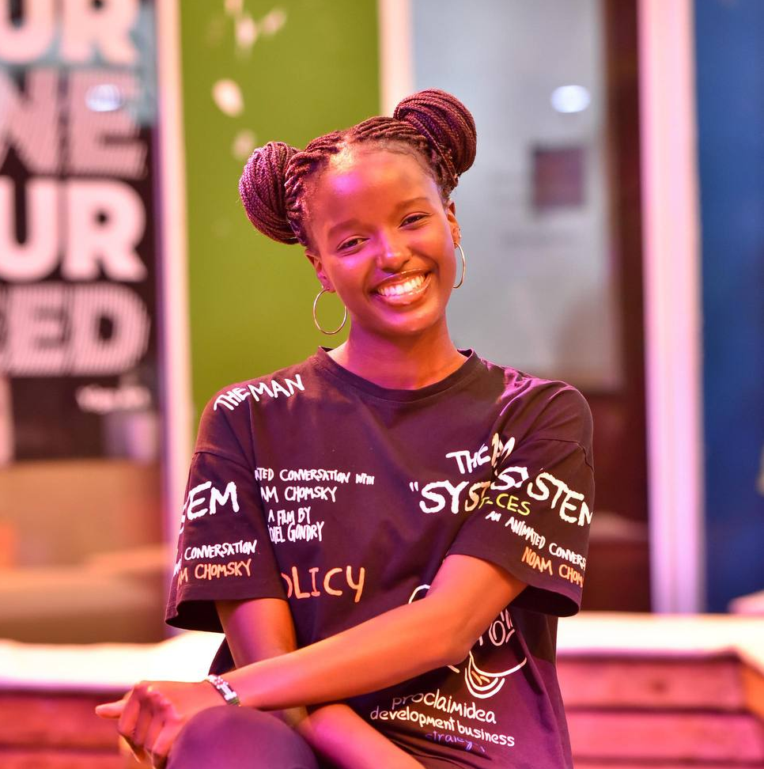
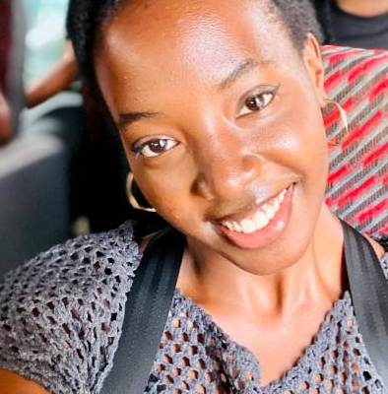
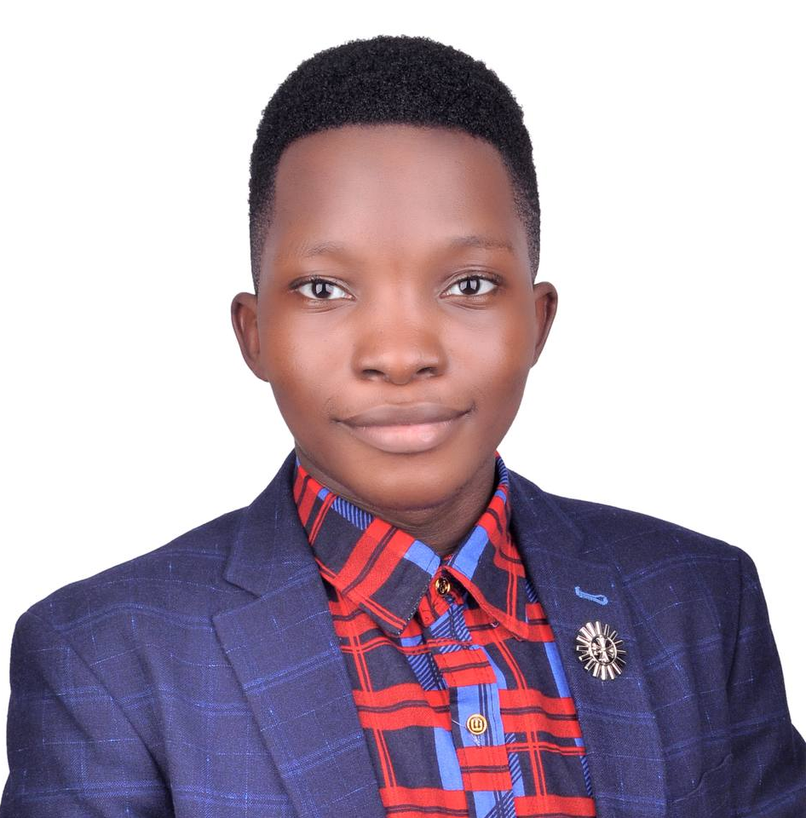

Participants
456
001
120
380
222
125
196
124
095
044
007

Slide 4
First Cohort Celebration
380
095

Slide 5
Program Objectives
Develop leadership skills that align with the 4-way test
Enhance leadership abilities to drive community service initiatives
Foster collaboration and networking among clubs

Slide 6
About Rotary
Club Leadership
District Leadership
General Courses
The Rotary Foundation
Professional Development
Courses Catalogs
Public Image
Service
Membership

Slide 7
Popular Courses
Fundraising Basics
Promoting Rotary on Social Media
Minimizing Risk
456
The Power of Giving
Managing Club Business
Rotary Foundation Basics
012
Leading Effective Committees
Strategies for Attracting New Members
001

Slide 8
Outcomes
Enhanced Leadership skills acquired
Improved project management abilities
Increased knowledge on focus areas
Stronger relationship and bonds with clubs

Slide 9

Challenges we faced
Time mgt. challenges
Limited feedback
Technical issues
Digital Literacy

Slide 10
Recommendations
001
Expanding the program openings
003
Enhancing mentorship and coaching
002
Developing strategic partnerships with more clubs
004
Increasing resources allocated to the program

Slide 11
Participation
Statistics
Enrolments: 22
Completions: 13
Clubs: 6
456
218

Slide 12
Clubs
represented
Rac Kigo Seven Lakes Golf
Rac Upper Kololo
Rac UCU Mukono
Rac Kigo
Rac Victoria University
Rac Rubaga Lakeview
456

Slide 13
Quote
“Shoot for the moon, and if you miss, you will fall among the stars”
-Les Brown

Slide 14
End of Presentation
067

Slide 15

Thank you for listening!

